Slide 1
Lecture 11
Sidra Khatoon

Slide 2
Flutter Animation
At the most basic level, animations in a Flutter app can be seen as one of two types: drawing-based, and code-based animations.
Drawing-based animations are animated graphics, vectors, characters, or anything that is “drawn” then animated.
On the other hand, code-based animations are focused on widget layouts and styles (lists, colors, text, ..etc).
Flutter animations allow you to create absolutely stunning, creative, and pretty complex animations without the need for 3rd party packages.
Code-based animations in Flutter have 2 types: Implicit animations & Explicit animations. In each of these types, you can either use ready-to-use widgets, or create your own widgets.

Slide 3
Implicit Animations
These are the simplest animations and easiest to use. Changing a value is enough to trigger an animation and Flutter handles everything behind the scenes.
Implicit Animations with Ready-to-use widgets: They’re called AnimatedFoo widgets, where Foo is the animated property. Most of them are animated versions of the widgets you already know and use, like Container/AnimatedContainer, Padding/AnimatedPadding, Positioned/AnimatedPositioned, …etc.
Here’s a full list of available AnimatedFoo widgets: AnimatedAlign, AnimatedContainer, AnimatedDefaultTextStyle, AnimatedOpacity, AnimatedPadding, AnimatedPhysicalModel, AnimatedPositioned, AnimatedPositionalDirectional and AnimatedSize
We have AnimatedFoo widgets for properties like opacity, padding, align, position, ..etc.

Slide 4
Implicit Animations
Implicit Animations with TweenAnimationBuilder: The TweenAnimationBuilder allows you to implicitly animate any property of any widget using a Tween class.
The Tween class takes its name from “Between”. It basically gives you a begin and end values to animate between.
The builder of the TweenAnimationBuilder widget gives you the animated value that you can apply to whatever property you want in the widgets you return in that builder.
We’re using the child param of the TweenAnimationBuilder widget builder for better performance as this child rebuilds only once instead of rebuilding every time the animation is triggered.

Slide 5
Explicit Animations
Explicit animations don’t animate until “explicitly” being told to animate. And you tell them to animate and how to animate and “control” their animation using an AnimationController.
Explicit animations also have ready-to-use widgets as well as widgets with an extra level of customization for you to go wild!
The AnimationController allows you to “control” the animation. To do that, it needs a vsync value of type TickerProvider. a Ticker basically keeps track of Flutter’s frames rendering and allows the controller to follow that ticker and “animate” through it within the specified duration, while linearly producing values between the lowerBound and the upperBound values which are by default 0 & 1.

Slide 6
Explicit Animations
Explicit Animations with Ready-to-Use Widgets: They’re called FooTransition widgets, where Foo is the animated property of the widget. Some of them are also animatable widgets of the regular widget you use, e.g. AlignTransition, PositionedTransition.
Here’s a full list of available FooTransition widgets: AlignTransition, DecoratedBoxTransition , DefaultTextStyleTransition,FadeTransition, PositionedTransition, RelativePositionedTransition, RotationTransition, ScaleTransition, SizeTransition,SlideTransition, StatusTransitionWidget
Explicit Animations with the AnimatedBuilder widget: In explicit animations, we can use the AnimatedBuilder widget to animate multiple widget properties. Or we can go a step further and use the AnimatedWidget class to create our own FooTransition!
If we want something other than the lowerBound & upperBound values of the AnimationController, we can create own Animation and hook it with the AnimationController and then give it to the AnimatedBuilder widget

Slide 7
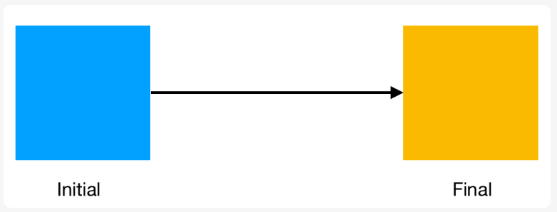
Tweens and their uses
Tweens are one of the most critical concepts in Flutter animations or in other words, to animating anything in Flutter.
Tweening stands for inbetweening. To understand what that means, look at the image below:

Slide 8
Tweens and their uses
We have a box with a blue background initially and we need to animate it to change the color to yellow.
Now, an abrupt color change looks terrible to the user.
The change has to be smooth. However, it is impossible for us to show all colors that lie between.
In such cases, we create a ColorTween, which gives us all the values in between blue and yellow so that we can display them.
A Tween gives us intermediate values between two values like colors, integers, alignments and almost anything you can think of.
The widget does not need to get the value from the tween directly. A tween is provided to the animation itself which gives us correct values at the right time.
In Flutter, you can define the tween as Tween<T> or use predefined classes like ColorTween which are specifically designed for this.

Slide 9
Animation Controllers
An animation controller is, as the name suggests, a way to control (trigger, fling or stop) an animation.
However, the main function of the controller is to drive the animation. This means it will cause the animation to change its value and return a new value from the Tween based on the progression of the Animation.
Every Flutter animation needs at least two elements to be created:
A Tween to get generate values for the animation
An AnimationController as parent
An AnimationController gives the progression of the animation from 0 to 1 whereas the Animation gives the actual tween value expected by the widget.
Animation controllers need to be disposed off once the navigation is complete.
The AnimationController also gives us control over how the animation behaves. For example, we can repeat an animation using controller.repeat().

Slide 10
